Slide 1

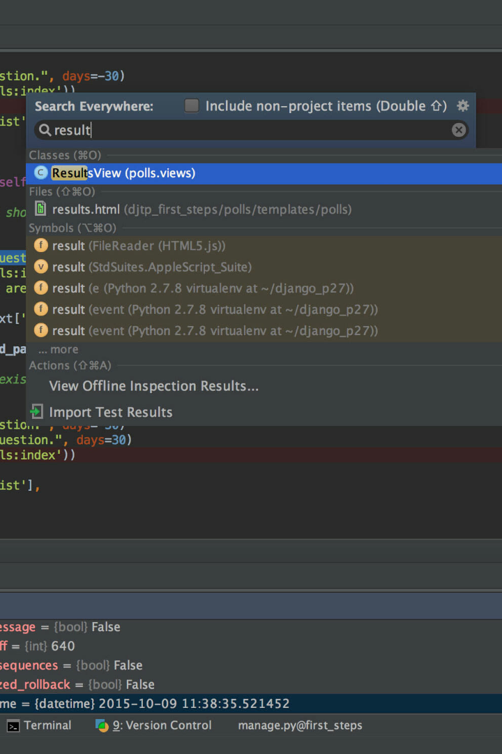
GUI Based Text Editor in Python
In this presentation, we will explore the world of GUI-based text editors in Python. Discover the importance of a GUI text editor in programming and learn how to create and enhance your own using the tkinter library.

Slide 2

What is a GUI Text Editor?
A GUI text editor provides a graphical interface for users to create, edit, and manipulate text-based documents. It simplifies the process of writing code, making it more accessible for developers of all skill levels.

Slide 3
Importance of a GUI Text Editor in Programming
A GUI text editor offers several advantages for programmers. It provides syntax highlighting, autocompletion, and error checking, improving code readability and productivity. It also allows for multiple file management and easy navigation between different sections of code.

Slide 4

Creating a GUI using tkinter
The tkinter library in Python allows us to design and build GUIs. We will dive into the basics of tkinter and explore how to design the layout of our text editor, add a text widget, and configure its appearance and behavior.

Slide 5

Implementing Text Editing Functionalities
Let's explore how to implement essential text editing functionalities in our GUI text editor. We'll learn how to open and save files, copy, cut, and paste text, and even implement undo and redo functionality to enhance productivity while coding.

Slide 6

Enhancing the GUI Text Editor
Take your GUI text editor to the next level by adding features like find and replace, allowing users to search for specific text patterns and replace them accordingly. Customize the editor's appearance, choose themes, and even add keyboard shortcuts for common actions.

Slide 7

Benefits of Using a GUI Text Editor in Python Programming
Using a GUI text editor in Python programming offers numerous benefits. It improves code organization, provides a visual representation of the code, and enhances productivity with its built-in functionalities. Discover the advantages and elevate your development workflow.

Slide 8

Conclusion
Throughout this presentation, we've explored the world of GUI-based text editors in Python. Now it's your turn to dive in, create your own GUI text editor, and unlock the full potential of your Python programming journey. Happy coding!
Resources for further learning and exploration:
Python Documentation: python.org/doc
Tkinter Documentation: python.org/tkinter
Thank You

